Slide 1
Text Mining Project on Toyota Dealership Survey
Phase 2 - HT Experience Classification

Slide 2
Methodology - CNN
Pre-Processing
Extract data (HT experience and labels) from CSV form.
Map label to integer, then represent using categorical one-hot encoding.
HT experience sentences cleaning, pre-processing, tokenizing, then pad sentences into same length using special padding character (<PAD/>).
Word Embedding
Use pre-trained word embedding ‘Word2Vec’ to represent each word (300 dimension).
Give zero embedding to special padding character (<PAD/>) and a random initialized vector to represent all the unknown words.

Slide 3
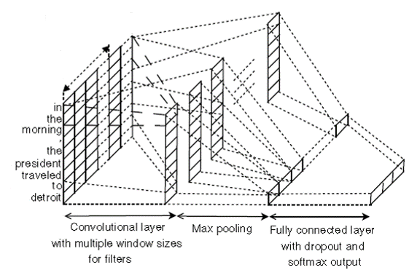
Methodology - CNN
CNN Architecture
word embedding

Slide 4
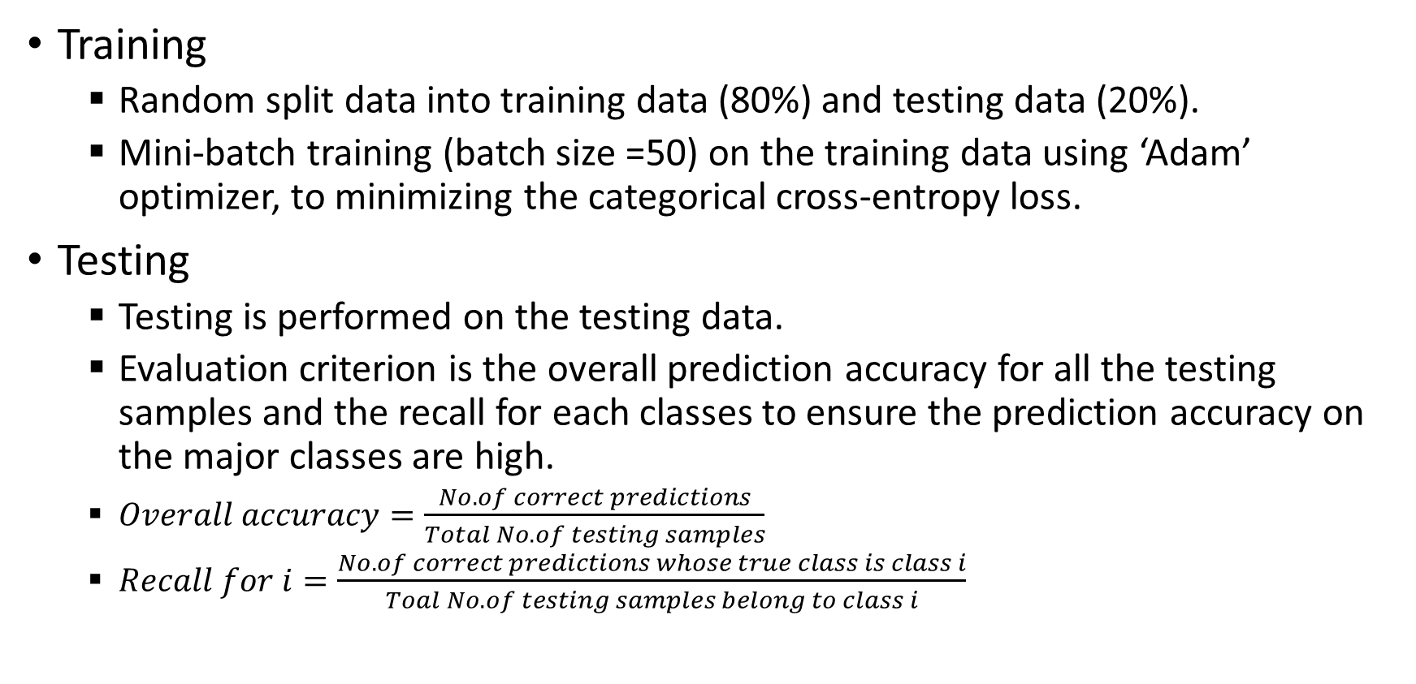
Methodology - CNN
Training
Random split data into training data (80%) and testing data (20%).
Mini-batch training (batch size =50) on the training data using ‘Adam’ optimizer, to minimizing the categorical cross-entropy loss.
Testing
Testing is performed on the testing data.
Evaluation criterion is the overall prediction accuracy for all the testing samples and the recall for each classes to ensure the prediction accuracy on the major classes are high.
$Overall accuracy=\frac{No. of correct predictions}{Total No. of testing samples}$
$Recall for i=\frac{No. of correct predictions whose true class is class i}{Toal No. of testing samples belong to class i}$

Slide 5
“Context” Category
Class Label Distribution
Classification Results
Overall accuracy: 81.2724%
Accuracy for 'Ordinary Situation': 0.8340
Accuracy for 'Problem': 0.9078
Accuracy for 'Emergency': 0.1148
Accuracy for 'Special Occasion': 0.4545
Label | Ordinary Situation | Problem | Emergency | Special Occasion
Count | 2615 | 2440 | 284 | 237
Freq | 46.90% | 43.76% | 5.09% | 4.25%

Slide 6


“Context” Category
Confusion Matrix
Label:
{u'emergency': 0 , u'ordinary situation': 1, u'problem': 2, u'special occasion': 3,}
Predicted Class
Predicted Class
True Class
True Class

Slide 7
“Content” Category
Class Label Distribution
Label | Roadside Assistance | Personal Need | Issue Resolution | Quick Service | Gift / Free Stuff | Pick up / Drop | Detailed Explanation
Count | 1231 | 1118 | 833 | 707 | 497 | 335 | 227
Freq | 22.08% | 20.05% | 14.94% | 12.68% | 8.91% | 6.01% | 4.07%
Label | Care from Staff | Snacks | Free Service / Discount | Others | Forgotten Stuff | dealer event
Count | 187 | 161 | 111 | 73 | 58 | 38
Freq | 3.35% | 2.89% | 1.99% | 1.31% | 1.04% | 0.68%
Classification Results
Overall accuracy: 61.111%
Accuracy for 'roadside assistance': 0.8728
Accuracy for 'personal need': 0.6364
Accuracy for 'issue resolution': 0.4973
Accuracy for 'quick service': 0.5496
Accuracy for 'gift / free stuff': 0.7658
Accuracy for 'pick up / drop': 0.5484
Accuracy for 'detailed explanation': 0.3396
Accuracy for 'care from staff': 0.2051
Accuracy for 'snacks': 0.7000
Accuracy for 'free service / discount': 0.4000
Accuracy for 'others': 0.0000
Accuracy for 'forgotten stuff': 0.0000
Accuracy for 'dealer event': 0.0000

Slide 8
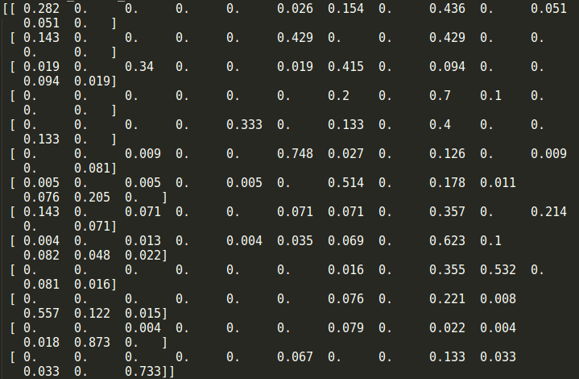
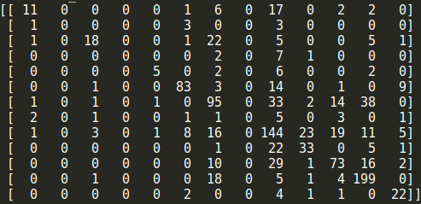
“Content” Category
Confusion Matrix
Label:
{u'care from staff': 0, u'dealer event': 1, u'detailed explanation': 2, u'forgotten stuff': 3 , u'free service / discount': 4, u'gift / free stuff': 5, u'issue resolution': 6, u'others': 7, u'personal need': 8, u'pick up / drop': 9, u'quick service': 10, u'roadside assistance': 11, u'snacks': 12,}
Predicted Class
Predicted Class
True Class
True Class

Slide 9
“Driver” Category
Class Label Distribution
Classification Results
Overall accuracy: 63.1720%
Accuracy for 'Caring Attitude': 0.8241
Accuracy for 'Flexibility': 0.4642
Accuracy for 'Expertise': 0.4000
Accuracy for 'Transparency': 0.0000
Accuracy for 'Others': 0.0000
Label | Caring Attitude | Flexibility | Expertise | Transparency | Others
Count | 3008 | 1383 | 1065 | 116 | 4
Freq | 53.95% | 24.80% | 19.10% | 2.08% | 0.07%

Slide 10


“Driver” Category
Confusion Matrix
Label:
{u'caring attitude': 0, u'expertise': 1, u'flexibility': 2, u'others': 3, u'transparency': 4,}
Predicted Class
Predicted Class
True Class
True Class

